Slide 1

ebpf

Slide 2



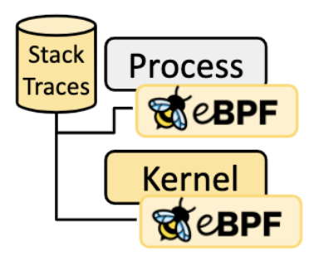


Data Collection
Attack Tools
Container-Based Cloud
Collect Tools
Pod
Pod
container
container
container
container
DeathStarBench
DeathStarBench
Applications
• • •
Applications
Data
Data
CloudWatch
Runtime
Runtime
Middleware
O/S
Servers
Storage
Network
MetsSploit

Slide 3
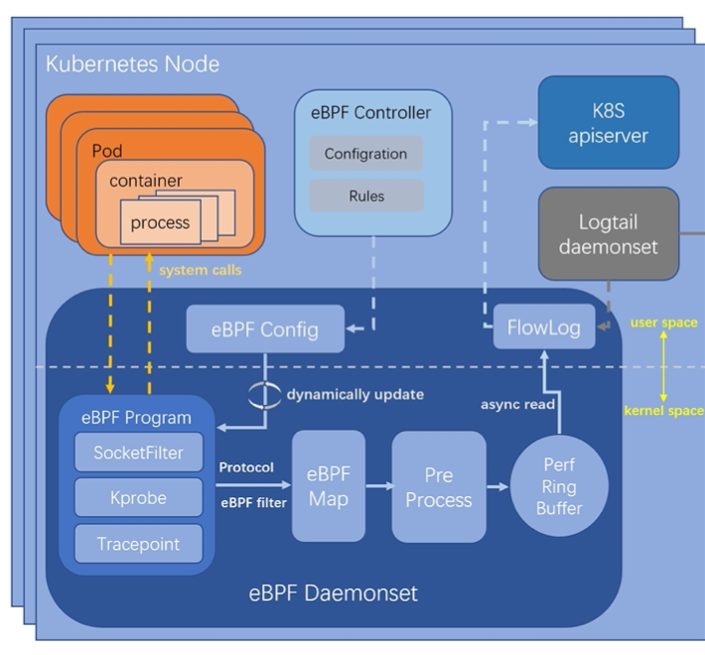
Collection Tools
Collect Tools
eBPF
A non- intrusive, efficient and accurate, fine-grained end-to-end observability solution that enables transparent data collection for applications, nodes, pods, containers, etc. in Kubernetes clusters
CloudWatch
Collects monitoring and operational data in the form of logs, metrics, and events, and visualizes it

Slide 4
Attack Tools
Attack Tools
MetaSploit
Opensource framework that probes systematic vulnerabilities on networks and servers
BurpSuit
Intercepting proxy server for security testing of web applications
Infection Monkey
Non-intrusive attack simulator
Possible Attacks
Brute-Force Attack
Using BurpSuit, perform dictionary attack targeting
Generate user requests http traffics to the user login microservice
Denial of Service Attack
Exploit long-running remote API calls to potentially amplify inter microservice communication
Send resource-heavy requests internally within the system to microservices in a way that they are indistinguishable from benign requests

Slide 5
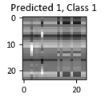

Deep Learning Methods
Class 1
Convolutional Neural Network (CNN)
Exploitation in a cloud has a certain pattern
container
container
Applications
Applications
Application
Data
Data
• • •
Data
Runtime
Runtime
Middleware
Platform
Data
O/S
Servers
Storage
Infrastructure
Data
Network

Slide 6
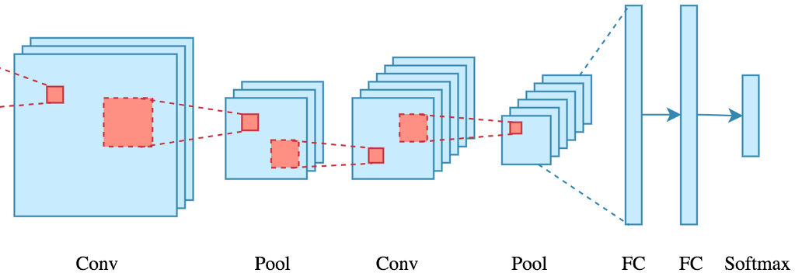
Deep Learning Methods
Convolutional Neural Network (CNN)
Will perform a series of Conv2D and MaxPooling2D to reduce the dimensionality followed by fully connected layers
Class 1
Predict 1, Class 1

Slide 8
Install Docker Engine
https://docs.docker.com/engine/install/ubuntu/
$ sudo apt-get update
$ sudo apt-get install \ ca-certificates \ curl \ gnupg \ lsb-release
$sudo mkdir -p /etc/apt/keyrings
$ curl -fsSL https://download.docker.com/linux/ubuntu/gpg | sudo gpg --dearmor -o /etc/apt/keyrings/docker.gpg
$ echo \ "deb [arch=$(dpkg --print-architecture) signed-by=/etc/apt/keyrings/docker.gpg] https://download.docker.com/linux/ubuntu \ $(lsb_release -cs) stable" | sudo tee /etc/apt/sources.list.d/docker.list > /dev/null
$sudo apt-get update
$ sudo apt-get install docker-ce docker-ce-cli containerd.io docker-compose-plugin
$sudo docker run hello-world

Slide 9
Install dockercompose
$ sudo apt-get install docker-compose-plugin
$ sudo apt install docker-compose

Slide 10
Instal python (3.5 or higher)
sudo apt install python3-pip
sudo pip3 install aiohttp
libssl-dev (apt-get install libssl-dev)
libz-dev (apt-get install libz-dev)
luarocks (apt-get install luarocks)
luasocket (luarocks install luasocket)
When sudo apt-get update does not work:
https://askubuntu.com/questions/29071/apt-get-update-cannot-find-ubuntu-servers

Slide 11
Run bcc in container using image
docker run -it --rm \
--privileged \
-v /lib/modules:/lib/modules:ro \
-v /usr/src:/usr/src:ro \
-v /etc/localtime:/etc/localtime:ro \
--workdir /usr/share/bcc/tools \
zlim/bcc

Slide 12
Bcc Tutorial
https://github.com/iovisor/bcc/blob/master/docs/tutorial.md#1-general-performance

Slide 13
Downgrade Kernel
uname -r
sudo add-apt-repository ppa:cappelikan/ppa
sudo apt install mainline
find /boot/vmli*
cd /etc/default/
sudo chmod 755 grub
vi grub (change default ‘1>2’)
Run mainline: install kernel version 5.0.0 and uninstall 5.4.0
sudo update-grub
sudo reboot

Slide 14
Downgrade Kernel
user1@ubuntu:/usr/share/bcc/tools$ mainline --list-installed
mainline 1.0.15
Distribution: Ubuntu 18.04.6 LTS
Architecture: amd64
Running kernel: 5.0.0-050000-generic
----------------------------------------------------------------------
Found installed: 5.4.0.110.124~18.04.95
Found installed: 5.4.0-110.124~18.04.1
Found installed: 5.4.0-109.123~18.04.1
Found installed: 5.0.0-050000.201903032031

Slide 15
Install bcc
sudo apt-key adv --keyserver keyserver.ubuntu.com --recv-keys 4052245BD4284CDD
echo "deb https://repo.iovisor.org/apt/$(lsb_release -cs) $(lsb_release -cs) main" | sudo tee /etc/apt/sources.list.d/iovisor.list
sudo apt-get update
sudo apt-get install bcc-tools libbcc-examples linux-headers-$(uname -r)

Slide 16
Install kubernates
https://phoenixnap.com/kb/install-kubernetes-on-ubuntu
Install kompse : convert the docker-compose.yml for kubernates
https://kompose.io/

Slide 17
$ sudo kubectl apply -f .
The connection to the server localhost:8080 was refused - did you specify the right host or port?
→ This problem can arise when you haven’t set the kubeconfig environment variable.

Slide 18
Run swarm instead of kubernates
connect this node to swarm
user1@ubuntu:~/DeathStarBench/socialNetwork$ sudo docker swarm init
Swarm initialized: current node (su2tkv0f6ebkzwhfbrf3f5os0) is now a manager.

Slide 19
Run swarm instead of kubernates
Start docker containers on a machine cluster with docker swarm
user1@ubuntu:~/DeathStarBench/socialNetwork$ sudo docker stack deploy --compose-file=docker-compose-swarm.yml jaeger-agent
Creating network jaeger-agent_default
Creating service jaeger-agent_media-memcached
Creating service jaeger-agent_social-graph-mongodb
Creating service jaeger-agent_nginx-web-server
Creating service jaeger-agent_user-memcached
Creating service jaeger-agent_social-graph-service
Creating service jaeger-agent_user-mention-service
Creating service jaeger-agent_jaeger-agent
Creating service jaeger-agent_user-service
Creating service jaeger-agent_jaeger-collector
Creating service jaeger-agent_user-mongodb
Creating service jaeger-agent_cassandra-schema
Creating service jaeger-agent_media-mongodb
Creating service jaeger-agent_social-graph-redis

Slide 20
Install Deathstarbench
user1@ubuntu:~/DeathStarBench/socialNetwork$ sudo docker-compose up –d
user1@ubuntu:~/DeathStarBench/socialNetwork$ python3 scripts/init_social_graph.py --graph=soc-twitter-follows-mun

Slide 21
Install Deathstarbench
user1@ubuntu:~/DeathStarBench/socialNetwork/wrk2$ make
user1@ubuntu:~/DeathStarBench/socialNetwork/wrk2$ ./wrk -D exp -t 10 -c 30 -d 50 -L -s ./scripts/social-network/compose-post.lua http://localhost:8080/wrk2-api/post/compose -R 10

